Slide 1
Chapter 3
Open Shortest Path First (OSPF)

Slide 2
Basic concepts
routed protocol
routing protocol
Route table
The information that router need to forward data is stored in a table, called ’route table’
Router check the destination address of the packet, and choose the next hop based on the information in route table.
Route table is stored in RAM
connected route
static route
dynamic route
default route
Route table composition
Destination address
Mask
Next hop address (Gateway)
Forwarding physical interface
Source of the information(Owner)
Route priority
metric

Slide 3
Route table composition
Example
Dest Mask Gw Interface Owner pri metric
172.16.8.0 255.255.255.0 1.1.1.1 fa_0/1.1 static 1 0
172.16.8.0 -- Destination network address
255.255.255.0 -- Destination network mask
1.1.1.1 -- Next hop address
fa_0/1.1 -- Route learning interface and forwarding interface
static -- how does router learns this entry
1 -- route priority
0 -- Metric
Routed protocol: IP, IPX, AppleTalk
Routing protocol: RIPv1 & 2, OSPF, EIGRP, IS-IS, BGP

Slide 4
Introduction to OSPF
OSPF(Open shortest path first) is:
  Classless
  Link-state routing protocol
  Uses areas for scalability
RFC 2328 defines the OSPF metric as an arbitrary value called cost.
  The IOS software uses bandwidth to calculate the OSPF cost metric.
OSPF is a Interior Gateway Protocol(IGP）,it is used within an AS to decide route.
O in OSPF means the standard is open，not private routing protocol such as IGRP and EIGRP of CISCO.

Slide 5
Summary of the whole slide
OSPF
Maintain three tables
Topology table
Neighbor table
Routing table
Use Dijkstra’s SPF algorithm to find best path
OSPF divides networks into multiple areas --goal: to localize updates within an area
Every area have a bunch of routers (50, 10, 100,…)
All routers on the same area have the same road-map
Requires a hierarchical design

Slide 6
OSPF Neighbor relationship forming steps
Determine own Router ID
Add interfaces to the link state database dictated by the network command
Send a hello message on chosen interfaces (called a down state) hello messages are sent once every 10 seconds on broadcast/ p-2-p networks and once every 30 seconds on NBMA networks.
What this (*) represents?
4. Receive hello message (Init state)
Checks all the (*) if they meet then go to step 5
5. Send replay hello message (2-way state) (check new or established)
OSPF hello message contains all sorts of information below
Router ID
Hello & dead timers *
Netmask*
Area ID*
Neighbors*
Router priority
DR/BDR IP address
Authentication password*

Slide 7
6. Master-Slave relationship determined (Ex-start state)- exchanging link state info starts using DBD packets, DBD=cliff notes of the LSD or summary
7. DBDs are acknowledged and received (Exchange state)
OSPF routing info is exchanged using DBDs packets, LSR, LSU
8. Neighbors are synchronized (Full state)
now neighbors have the same LSD and at this step adjacency has been established.
And Now it is time to run Dijkstra’s SPF algo. to figure out best path
How the neighbors look at each other?
How adjacency look at each other?

Slide 8
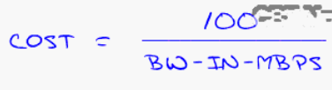
Now we can figure out the best route by running SPF algorithm based on bandwidth of the interface speed
All of the routers find best path by using OSPF’s cost formula
OSPF’s
Common costs
56k=1785
64k=1562
T1 (1.544)=65
E1 (2.048)=48
Ethernet= 10
Fast Ethernet=1
OSPF network types
Broadcast
NBMA
P2P
P2multipoint

Slide 9
DR and BDR
For every shared network segments there must be DR/BDR which determine how the OSPF propagates updates and eliminates huge amount of network traffic.
How they are elected as DR and BDR?
OSPF packet types
OSPF configuration on a single area
Verifying OSPF configuration on a single area
OSPF configuration on multiple areas
Verifying OSPF configuration on multiple areas
OSPF configuration for NBMA
Configuring OSPF authentication
Special OSPF areas

Slide 10
Router ID：Identify every router. Router ID is the router’s name in the OSPF process.
The OSPF router ID will be one of the following:
• Address defined by the router-id command
• Highest IP address of a loopback interface
• Highest IP address of an active interface configured to run OSPF
Usually it is highest active interface IP address assigned to a router when OSPF starts is the router ID.
If Loopback interface is used on the router, then router ID is the highest IP address among all the Loopback interface. Loopback interfaces beat physical interfaces.
Hardcode the router ID using the router ID command which never gets beat by the physical interfaces.
Router (config-router)# router-id IP-address
Notes:
This data field can include one of five OSPF packet types.
In the IP packet header:
Protocol field is set to 89 (OSPF)
Destination address is typically set to one of two multicast addresses:
224.0.0.5
224.0.0.6
If the OSPF packet is encapsulated in an Ethernet frame, the destination MAC address is also a multicast address:
01-00-5E-00-00-05
01-00-5E-00-00-06

Slide 11
OSPF in IP Packets
89 - OSPF 6 - TCP
17 - UDP
Frame Payload
C
R
C
Frame Header
IP Header
Protocol Number
Packet Payload
In the IP packet header:
  Protocol field is set to 89 (OSPF)
  Destination address is typically set to one of two multicast addresses:
    224.0.0.5
    224.0.0.6
Destination MAC address is also a multicast address:
  01-00-5E-00-00-05
  01-00-5E-00-00-06

Slide 12
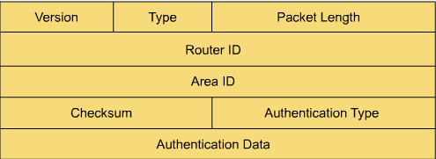
OSPF Packet Header
Version——identify OSPF version
Type——identify OSPF data packet types as follows:
  Hello packet : setup and maintain the relationship with neighbors
  Database Description Packet(DDP):
  describe the content of network topology database
  Link state request(LSR)
  request information from neighbor router from its network topology database
  Link state update(LSU)---Reply to LSR packet
  Link state Acknowledge (LSAck) Acknowledge to LSU packet, making OSPF more reliable

Slide 13
OSPF packet header
Packet Length——in bytes to identify the length of packet, including OSPF header;
Router ID——identify the sender of the packet;
Area ID——identify the area of the packet. Every OSPF packet is related to an area;
Checksum——Check the content of the entire packet to find some mistakes in transmitting;
Authentication Type——Including following types: 0 means no authentication,1 means using plain text to authenticate,2 means using MD5 algorithm. All the information exchanged in OSPF can be authenticated, authentication type can be configured for each area;
Authentication data——data(including encapsulated upper layer data) with authentication information

Slide 14
OSPF Terminology
Interface：The connection between router and the network having only one IP address and mask. It is also called link.
Broadcast Network：Network that supports broadcasting such as Ethernet.
Non－Broadcast Network: Network that does not support broadcasting such as Frame Relay and X.25.

Slide 15
Designated Router(DR) and Backup Designated Router (BDR)：In a broadcast network elect a DR and BDR to represent the network. This is to reduce the traffic on network.
Adjacency：This relationship is formed between DR and undesignated router in broadcast network or NBMA network.
Neighboring Routers：Routers which have interface to a common network

Slide 16
Neighbor Database：Including all the routers which have adjacency relationship.
Link State Database：Including all the adjacency status between routers in the network. It shows the topology of a network. This database is the same for all the routers within an area.
Routing Table：It is also called forwarding table, it is calculated with SPF algorithm based on the link state database.
Router type：Different types of routers act different on controlling data coming in and going out. Router has a separate link state database for each area it connects to. Two routers that belong to one area has the same area link stare database.
Link state advertisement（LSA）：Describe the local status of a router. In OSPF network, there are 6 types of LSA.
Route Summarization：Routes from one area, from another AS and from another kind of routing protocols can be combined together as a route summarization, if the design of the network is correct.

Slide 17
OSPF has following advantages:
  Choose path based on bandwidth
  Fast convergence
  Support VLSM and CIDR
  Better hierarchical structure
  Equal cost multipath
  OSPF is classless and allows summarization.
  It uses multicasts instead of broadcasts.
  It sends incremental change-based updates.
Link-state routing protocols may have two problems：
  At the first discovering process, link-state protocols will flood data on the line，thus weakening the data transferring capabilities.
  Link-state routing protocols are sensitive to storage size and processor capability.

Slide 18
OSPF Packet Types
Five types of OSPF LSPs (link-state packets).
  Hello: Used to establish and maintain adjacency.
  DBD (Database Description): Abbreviated list of the sending router’s link-state database.
  LSR (Link-State Request) : Used by routers to request more information about any entry in the DBD.
  LSU: (Link-State Update): Link-state information.
  LSAck (LSA Acknowledgment): Router sends a link-state (LSAck) to confirm receipt of the LSU.
Notes:
Five types of OSPF LSPs (link-state packets).
Hello: Used to establish and maintain adjacency.
DBD (Database Description): Abbreviated list of the sending router’s link-state database.
LSR (Link-State Request) : Used by routers to request more information about any entry in the DBD.
LSU: (Link-State Update): Link-state information.
LSAck (LSA Acknowledgment): Router sends a link-state (LSAck) to confirm receipt of the LSU.

Slide 19
Hello Protocol
Hello packets :
Discover neighbors (OSPF neighbors)
Establish adjacencies
Advertise parameters on which two routers must agree to become neighbors:
  Hello Interval, Dead Interval, Network Type
Elect the Designated Router and Backup Designated Router on multiaccess networks such as Ethernet and Frame Relay.
Notes:
Discover neighbors (OSPF neighbors)
Establish adjacencies
Advertise parameters on which two routers must agree to become neighbors
Hello Interval, Dead Interval, Network Type
Elect the Designated Router and Backup Designated Router on multiaccess networks such as Ethernet and Frame Relay

Slide 20


Slide 21
OSPF Packet Types
Type: OSPF packet type: Hello (Type 1), DBD (Type 2), LS Request (Type 3), LS Update (Type 4), LS ACK (Type 5).
Router ID: ID of the originating router.
Area ID: Area from which the packet originated.
Network Mask: Subnet mask associated with the sending interface.
Hello Interval: Number of seconds between the sending router’s Hellos.
Router Priority: Used in DR/BDR election.
Designated Router (DR): Router ID of the DR, if any.
Backup Designated Router (BDR): Router ID of the BDR, if any.
List of Neighbors: Lists the OSPF Router ID of the neighboring router(s).
Notes:
Type: OSPF packet type: Hello (Type 1), DBD (Type 2), LS Request (Type 3), LS Update (Type 4), LS ACK (Type 5)
Router ID: ID of the originating router
Area ID: Area from which the packet originated
Network Mask: Subnet mask associated with the sending interface
Hello Interval: Number of seconds between the sending router’s Hellos
Router Priority: Used in DR/BDR election (discussed later)
Designated Router (DR): Router ID of the DR, if any
Backup Designated Router (BDR): Router ID of the BDR, if any
List of Neighbors: Lists the OSPF Router ID of the neighboring router(s)

Slide 22
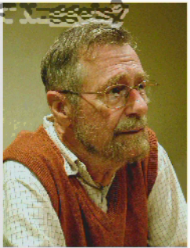

Slide 23
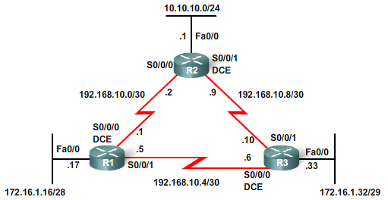
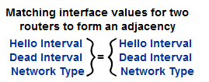
Neighbor Establishment, OSPF Hello and Dead Intervals
Hello, I’m R2
Hello, I’m R3
Hello, I’m R1
Before an OSPF router can flood its link states, must discover neighbors.
Before two routers can form an OSPF neighbor adjacency, they must agree on three values:
  Hello interval
  Dead interval
  Network type
Both the interfaces must be part of the same network, including having the same subnet mask.
Notes:
Before an OSPF router can flood its link states, must discover neighbors.
Receipt confirms there is another OSPF router on this link.
Adjacency is now established.
Routers are not considered fully adjacent, at this point each router is aware of the other OSPF router on the link.
Before two routers can form an OSPF neighbor adjacency, they must agree on three values:
Hello interval
Dead interval
Network type
Both the interfaces must be part of the same network, including having the same subnet mask.

Slide 24
Hello Intervals
Hello, I’m R2
Hello, I’m R3
Hello, I’m R1
By default, OSPF Hello packets are sent:
  10 seconds on multiaccess and point-to-point segments
  30 seconds on nonbroadcast multiaccess (NBMA) segments (Frame Relay, X.25, ATM).
Sent to ALL SPF Routers at 224.0.0.5
Notes:
By default, OSPF Hello packets are sent:
10 seconds on multiaccess and point-to-point segments
30 seconds on nonbroadcast multiaccess (NBMA) segments (Frame Relay, X.25, ATM).
In most cases, OSPF Hello packets are sent as multicast to an address reserved for ALLSPFRouters at 224.0.0.5.

Slide 25
Dead Intervals
Hello, I’m R2
Hello, I’m R3
Hello, I’m R1
Dead interval - Period, expressed in seconds, that the router will wait to receive a Hello packet before declaring the neighbor “down.”
It uses a default of four times the Hello interval.
  40 seconds - Multiaccess and point-to-point segments.
  120 seconds - NBMA networks.
When Dead interval expires:
  OSPF removes that neighbor from its link-state database.
  Floods the link-state information about the “down” neighbor out all OSPF-enabled interfaces.
Notes:
Dead interval - Period, expressed in seconds, that the router will wait to receive a Hello packet before declaring the neighbor “down.”
Cisco uses a default of four times the Hello interval.
40 seconds - Multiaccess and point-to-point segments.
120 seconds - NBMA networks.
Dead interval expires
OSPF removes that neighbor from its link-state database.
Floods the link-state information about the “down” neighbor out all OSPF-enabled interfaces.
Network types are discussed later in the chapter.

Slide 26
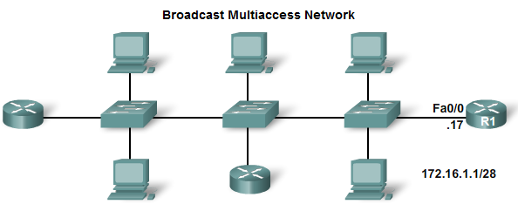
Electing a DR and BDR
Election of Designated Router (DR) and Backup Designated Router (BDR).
  Used to reduce the amount of OSPF traffic on multiaccess networks.
  DR is responsible for updating all other OSPF routers.
  BDR is the backup if the current DR fails.
Notes:
Election of Designated Router (DR) and Backup Designated Router (BDR).
Used to reduce the amount of OSPF traffic on multiaccess networks
DR is responsible for updating all other OSPF routers.
BDR is the backup if the current DR fails.
R1, R2, and R3 are connected through point-to-point links.
No DR/BDR election occurs.
Much more later

Slide 27
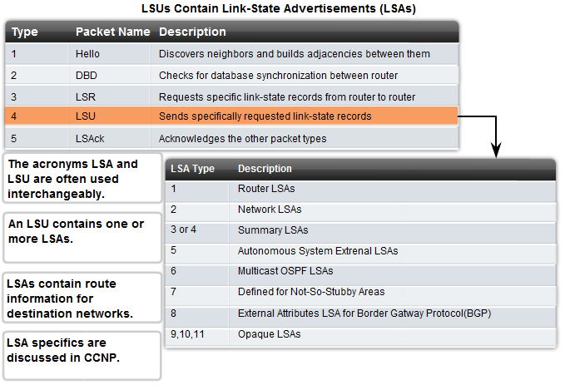
OSPF LSUs
Link-State Updates (LSU) are the packets used for OSPF routing updates.
  Can contain 11 different types of LSAs (Link-State Advertisements)
At times, these terms are used interchangeably.
Notes:
Link-State Updates (LSU) are the packets used for OSPF routing updates.
Can contain 11 different types of LSAs (Link-State Advertisements) (CCNP)
At times, these terms are used interchangeably.

Slide 28
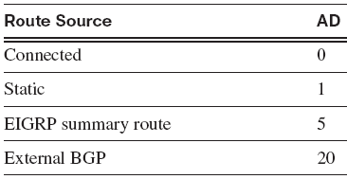
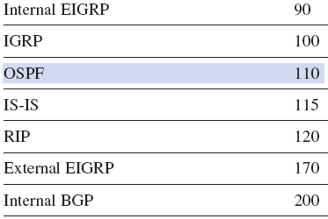
Administrative Distance
Administrative distance (AD) is the trustworthiness (or preference) of the route source.
OSPF has a default AD of 110.
Notes:
Administrative distance (AD) is the trustworthiness (or preference) of the route source.
OSPF has a default AD of 110.

Slide 29
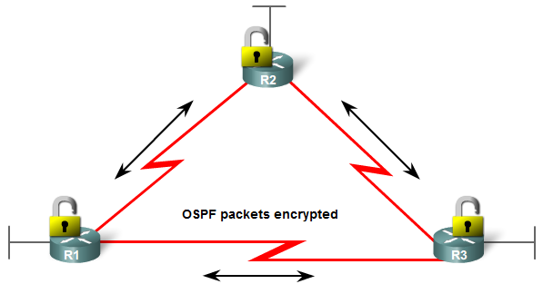
Authentication
OSPF can be configured to authenticate OSPF messages.
Notes:
OSPF can be configured for authentication.
This practice ensures that routers will only accept routing information from other routers that have been configured with the same password or authentication information.

Slide 30
Basic OSPF Configuration
Lab Topology
The router OSPF command
The network command
OSPF Router ID
Verifying OSPF
Examining the Routing Table

Slide 31
Topology
Notice that the addressing scheme is discontiguous.
Three serial links of various bandwidths.
Notes:
Notice that the addressing scheme is discontiguous.
OSPF is a classless routing protocol.
There are three serial links of various bandwidths and that each router has multiple paths to each remote network.

Slide 32
R1’s configuration
hostname R1
!
interface FastEthernet0/0
description R1 LAN
ip address 172.16.1.17 255.255.255.240
!
interface Serial0/0/0
description Link to R2
ip address 192.168.10.1 255.255.255.252
clock rate 64000
!
interface Serial0/0/1
description Link to R3
ip address 192.168.10.5 255.255.255.252
The current configurations do not include the interface bandwidth command.
This means that the bandwidth value on the serial interfaces is set to the default value of 1544 Kbps.
Notes:
The current configurations do not include the interface bandwidth command.
This means that the bandwidth value on the serial interfaces is set to the default value of 1544 Kbps.

Slide 33
R2’s configuration
hostname R2
!
interface FastEthernet0/0
description R2 LAN
ip address 10.10.10.1 255.255.255.0
!
interface Serial0/0/0
description Link to R1
ip address 192.168.10.2 255.255.255.252
!
interface Serial0/0/1
description Link to R3
ip address 192.168.10.9 255.255.255.252
clock rate 64000

Slide 34
R3’s configuration
hostname R3
!
interface FastEthernet0/0
description R3 LAN
ip address 172.16.1.33 255.255.255.248
!
interface Serial0/0/0
description Link to R1
ip address 192.168.10.6 255.255.255.252
clockrate 64000
!
interface Serial0/0/1
description Link to R2
ip address 192.168.10.10 255.255.255.252

Slide 35
The router ospf Command
R1(config)# router ospf 1
R1(config-router)#
The process-id
  Between 1 and 65,535
  Chosen by the network administrator.
Locally significant:
  Does not have to match other OSPF routers.
We are using the same process ID simply for consistency.
Notes:
The process-id
Between 1 and 65,535
Chosen by the network administrator.
Locally significant:
Does not have to match other OSPF routers.
This differs from EIGRP.
We are using the same process ID simply for consistency.

Slide 36
The network Command
Router(config-router)# network network-address wildcard-mask area area-id
The network command (same function as when used with other IGP routing protocols)
  Any interfaces on a router that match the network address in the network command will be enabled to send and receive OSPF packets.
  This network (or subnet) will be included in OSPF routing updates.
Requires the wildcard mask.
  Used to specify the interface or range of interfaces that will be enabled for OSPF.
Notes:
The network command (same function as when used with other IGP routing protocols):
Any interfaces on a router that match the network address in the network command will be enabled to send and receive OSPF packets.
This network (or subnet) will be included in OSPF routing updates.
Requires the wildcard mask.
Used to specify the interface or range of interfaces that will be enabled for OSPF.

Slide 37
The network Command
Router(config-router)# network network-address wildcard-mask area area-id
255.255.255.255
- 255.255.255.240 Subtract the subnet mask
---------------
0. 0. 0. 15 Wildcard mask
The wildcard mask can be configured as the inverse of a subnet mask.
Notes:
The wildcard mask can be configured as the inverse of a subnet mask.
R1’s FastEthernet 0/0 interface is on the 172.16.1.16/28 network.
The subnet mask for this interface is /28 or 255.255.255.240
The wildcard mask would be 0.0.0.15.
Note:
Like EIGRP, some Cisco IOS software versions allow you to simply enter the subnet mask instead of the wildcard mask.
The Cisco IOS software then converts the subnet mask to the wildcard mask format.

Slide 38
The network Command
Router(config-router)# network network-address wildcard-mask area area-id
The area area-id refers to the OSPF area.
A group of routers that share link-state information.
  Identical link-state databases.
We configure all the OSPF routers within a single area.
  This is known as single-area OSPF.
The network commands must be configured with the same area ID on all routers.
  Good practice to use an area ID of 0 with single-area OSPF.
Notes:
The area area-id refers to the OSPF area.
A group of OSPF routers that share link-state information.
All OSPF routers in the same area must have the same link-state information in their link-state databases.
This is accomplished by routers flooding their individual link states to all other routers in the area.
In this chapter, we configure all the OSPF routers within a single area.
This is known as single-area OSPF.
The network commands must be configured with the same area ID on all routers.
Although any area ID can be used, it is good practice to use an area ID of 0 with single-area OSPF.
This convention makes it easier if the network is later configured as multiple OSPF areas where area 0 becomes the backbone area.
Mult-Area OSPF is discussed in CCNP.

Slide 39
Configure the network Commands
Router-ID does NOT have to be the same on all routers
R1(config)# router ospf 1
R1(config-router)# network 172.16.1.16 0.0.0.15 area 0
R1(config-router)# network 192.168.10.0 0.0.0.3 area 0
R1(config-router)# network 192.168.10.4 0.0.0.3 area 0
R2(config)# router ospf 1
R2(config-router)# network 10.10.10.0 0.0.0.255 area 0
R2(config-router)# network 192.168.10.0 0.0.0.3 area 0
R2(config-router)# network 192.168.10.8 0.0.0.3 area 0
R3(config)# router ospf 1
R3(config-router)# network 172.16.1.32 0.0.0.7 area 0
R3(config-router)# network 192.168.10.4 0.0.0.3 area 0
R3(config-router)# network 192.168.10.8 0.0.0.3 area 0
Area-ID must be the same on all routers
Wildcard mask must be used
network commands for all three routers, enabling OSPF on all interfaces.
At this point, all routers should be able to ping all networks.
Notes:
network commands for all three routers, enabling OSPF on all interfaces.
At this point, all routers should be able to ping all networks.

Slide 40
OSPF Router ID
What’s my Router ID?
What’s my Router ID?
64 Kbps
What’s my Router ID?
128 Kbps
256 Kbps
OSPF Router ID is an IP address used to uniquely identify an OSPF router.
  Also used in the DR and BDR selection process.
Notes:
OSPF Router ID is an IP address used to uniquely identify an OSPF router.
Also used in the DR and BDR process. (later)

Slide 41
OSPF Router ID
What’s my Router ID?
What’s my Router ID?
64 Kbps
What’s my Router ID?
128 Kbps
256 Kbps
Routers derive the router ID based on three criteria and with the following precedence:
  1. IP address configured with the OSPF router-id command.
  2. Highest IP address of any of its loopback interfaces.
  3. Highest active IP address of any of its physical interfaces.
Notes:
Cisco routers derive the router ID based on three criteria and with the following precedence:
1. Use the IP address configured with the OSPF router-id command.
2. If the router ID is not configured, the router chooses the highest IP address of any of its loopback interfaces.
3. If no loopback interfaces are configured, the router chooses the highest active IP address of any of its physical interfaces.
The interface does not need to be enabled for OSPF, i.e. it does not need to be included in one of the OSPF network commands.

Slide 42
OSPF Router ID
64 Kbps
128 Kbps
256 Kbps
If no router IDs or loopback interfaces have been configured what would be the Router ID of each router?
  R1: 192.168.10.5, which is higher than either 172.16.1.17 or 192.168.10.1
  R2: 192.168.10.9, which is higher than either 10.10.10.1 or 192.168.10.2
  R3: 192.168.10.10, which is higher than either 172.16.1.33 or 192.168.10.6
Notes:
Because we have not configured router IDs or loopback interfaces on our three routers, the router ID for each router is determined by the third criterion in the preceding list: the highest active IP address on any of the router’s physical interfaces.
R1: 192.168.10.5, which is higher than either 172.16.1.17 or 192.168.10.1
R2: 192.168.10.9, which is higher than either 10.10.10.1 or 192.168.10.2
R3: 192.168.10.10, which is higher than either 172.16.1.33 or 192.168.10.6

Slide 43
Verifying the Router ID
show ip ospf can also be used
R1# show ip protocols
Routing Protocol is “ospf 1”
Outgoing update filter list for all interfaces is not set
Incoming update filter list for all interfaces is not set
Router ID 192.168.10.5
<output omitted>
R2# show ip protocols
Routing Protocol is “ospf 1”
Outgoing update filter list for all interfaces is not set
Incoming update filter list for all interfaces is not set
Router ID 192.168.10.9
<output omitted>
R3# show ip protocols
Routing Protocol is “ospf 1”
Outgoing update filter list for all interfaces is not set
Incoming update filter list for all interfaces is not set
Router ID 192.168.10.10
<output omitted>

Slide 44
Loopback Address
Save running-configs to startup configs and power cycle network.
Router(config)# interface loopback number
Router(config-if)# ip address ip-address subnet-mask
R1(config)# interface loopback 0
R1(config-if)# ip address 10.1.1.1 255.255.255.255
R2(config)# interface loopback 0
R2(config-if)# ip address 10.2.2.2 255.255.255.255
R3(config)# interface loopback 0
R3(config-if)# ip address 10.3.3.3 255.255.255.255
The advantage of using a loopback interface is that, unlike physical interfaces, it cannot fail.
OSPF router-id command, is a fairly recent addition to IOS software,
More common to find loopback addresses used for configuring OSPF router IDs.
Notes:
The advantage of using a loopback interface is that, unlike physical interfaces, it cannot fail.
Because the OSPF router-id command, which is discussed next, is a fairly recent addition to Cisco IOS software, it is more common to find loopback addresses used for configuring OSPF router IDs.

Slide 45
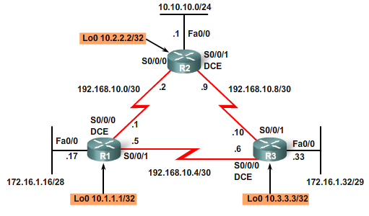
Topology with Loopback Addresses
1. Use the IP address configured with the OSPF router-id command.
2. Highest IP address of any of its loopback interfaces.
3. Highest active IP address of any of its physical interfaces.
Notes:
1. Use the IP address configured with the OSPF router-id command.
2. Highest IP address of any of its loopback interfaces.
3. Highest active IP address of any of its physical interfaces.

Slide 46
OSPF router-id Command
Router(config)# router ospf process-id
Router(config-router)# router-id ip-address
The OSPF router-id command was introduced in IOS Software Release 12.0(T)
Takes precedence over loopback and physical interface IP addresses for determining the router ID.
1. Use the IP address configured with the OSPF router-id command.
2. Highest IP address of any of its loopback interfaces.
3. Highest active IP address of any of its physical interfaces.
Notes:
The OSPF router-id command was introduced in Cisco IOS Software Release 12.0(T) and takes precedence over loopback and physical interface IP addresses for determining the router ID.
1. Use the IP address configured with the OSPF router-id command.
2. Highest IP address of any of its loopback interfaces.
3. Highest active IP address of any of its physical interfaces.

Slide 47
Modifying the Router ID
The router ID is selected when OSPF is configured with its first OSPF network command.
If the OSPF router-id command or the loopback address is configured after the OSPF network command, the router ID is derived from the interface with the highest active IP address.
The router ID can be modified with the IP address from a subsequent OSPF router-id command by reloading the router or by using the following command:
Router# clear ip ospf process
Modifying a router ID with a new loopback or physical interface IP address may require reloading the router.
Notes:
The router ID is selected when OSPF is configured with its first OSPF network command.
If the OSPF router-id command or the loopback address is configured after the OSPF network command, the router ID is derived from the interface with the highest active IP address.
The router ID can be modified with the IP address from a subsequent OSPF router-id command by reloading the router or by using the following command:
Router# clear ip ospf process
Modifying a router ID with a new loopback or physical interface IP address may require reloading the router.

Slide 48
Duplicate Router IDs
%OSPF-4-DUP_RTRID1: Detected router with duplicate router ID
If the router ID is the same on two neighboring routers, the neighbor establishment might not occur.
When duplicate OSPF router IDs occur, the IOS software displays a message above.
Notes:
When two routers have the same router ID in an OSPF domain, routing might not function properly.
If the router ID is the same on two neighboring routers, the neighbor establishment might not occur.
When duplicate OSPF router IDs occur, Cisco IOS software displays a message above.

Slide 49
Verifying New Router IDs (Loopbacks)
R1# show ip protocols
Routing Protocol is “ospf 1”
Outgoing update filter list for all interfaces is not set
Incoming update filter list for all interfaces is not set
Router ID 10.1.1.1
<output omitted>
R2# show ip protocols
Routing Protocol is “ospf 1”
Outgoing update filter list for all interfaces is not set
Incoming update filter list for all interfaces is not set
Router ID 10.2.2.2
<output omitted>
R3# show ip protocols
Routing Protocol is “ospf 1”
Outgoing update filter list for all interfaces is not set
Incoming update filter list for all interfaces is not set
Router ID 10.3.3.3
<output omitted>

Slide 50
Verifying OSPF
R1# show ip ospf neighbor
Neighbor ID Pri State Dead Time Address Interface
10.3.3.3 1 FULL/ - 00:00:30 192.168.10.6 Serial0/0/1
10.2.2.2 1 FULL/ - 00:00:33 192.168.10.2 Serial0/0/0
R2# show ip ospf neighbor
Neighbor ID Pri State Dead Time Address Interface
10.3.3.3 1 FULL/ - 00:00:36 192.168.10.10 Serial0/0/1
10.1.1.1 1 FULL/ - 00:00:37 192.168.10.1 Serial0/0/0
R3# show ip ospf neighbor
Neighbor ID Pri State Dead Time Address Interface
10.2.2.2 1 FULL/ - 00:00:34 192.168.10.9 Serial0/0/1
10.1.1.1 1 FULL/ - 00:00:38 192.168.10.5 Serial0/0/0
The show ip ospf neighbor command enables you to verify and troubleshoot OSPF neighbor relationships.
Notes:
The show ip ospf neighbor command enables you to verify and troubleshoot OSPF neighbor relationships.

Slide 51
Verifying OSPF
R1# show ip ospf neighbor
Neighbor ID Pri State Dead Time Address Interface
10.3.3.3 1 FULL/ - 00:00:30 192.168.10.6 Serial0/0/1
10.2.2.2 1 FULL/ - 00:00:33 192.168.10.2 Serial0/0/0
Neighbor ID: The router ID of the neighboring router.
Pri: The OSPF priority of the interface.
State: The OSPF state of the interface.
  FULL state means that the router’s interface is fully adjacent with its neighbor and they have identical OSPF link-state databases.
Dead Time: The amount of time remaining that the router will wait to receive an OSPF Hello packet from the neighbor before declaring the neighbor down.
  This value is reset when the interface receives a Hello packet.
Address: The IP address of the neighbor’s interface to which this router is directly connected.
Interface: The interface on which this router has formed adjacency with the neighbor.
Notes:
Neighbor ID: The router ID of the neighboring router.
Pri: The OSPF priority of the interface. (later)
State: The OSPF state of the interface.
FULL state means that the router’s interface is fully adjacent with its neighbor and they have identical OSPF link-state databases.
OSPF states are discussed in CCNP.
Dead Time: The amount of time remaining that the router will wait to receive an OSPF Hello packet from the neighbor before declaring the neighbor down.
This value is reset when the interface receives a Hello packet.
Address: The IP address of the neighbor’s interface to which this router is directly connected.
Interface: The interface on which this router has formed adjacency with the neighbor.

Slide 52
Verifying OSPF
R1# show ip ospf neighbor
Neighbor ID Pri State Dead Time Address Interface
10.3.3.3 1 FULL/ - 00:00:30 192.168.10.6 Serial0/0/1
10.2.2.2 1 FULL/ - 00:00:33 192.168.10.2 Serial0/0/0
Excellent command to begin troubleshooting.
  Routers must first form an adjacency before link-state information can be exchanged.
Note: On multiaccess networks such as Ethernet, two routers that are adjacent may have their states displayed as 2WAY.
Notes:
Excellent command to begin troubleshooting.
Routers must first form an adjacency before link-state information can be exchanged.
Then routes will be added to the routing table
Note: On multiaccess networks such as Ethernet, two routers that are adjacent may have their states displayed as 2WAY.
This is discussed in a later section.

Slide 53
Verifying OSPF
R1# show ip ospf interface serial 0/0/0
Serial0/0/0 is up, line protocol is up
Internet Address 192.168.10.1/30, Area 0
Process ID 1, Router ID 10.1.1.1, Network Type POINT_TO_POINT, Cost: 64
Transmit Delay is 1 sec, State POINT_TO_POINT,
Timer intervals configured, Hello 10, Dead 40, Wait 40, Retransmit 5
<output omitted>
Two routers may not form an OSPF adjacency if:
  Subnet masks do not match
  OSPF Hello or Dead timers do not match.
  OSPF network types do not match.
  There is a missing or incorrect OSPF network command.
Other powerful OSPF troubleshooting commands include the following:
  show ip protocols
  show ip ospf
  show ip ospf interface
Notes:
Two routers may not form an OSPF adjacency if:
The subnet masks do not match, causing the routers to be on separate networks.
OSPF Hello or Dead timers do not match.
OSPF network types do not match.
There is a missing or incorrect OSPF network command.
Other powerful OSPF troubleshooting commands include the following:
show ip protocols
show ip ospf
show ip ospf interface

Slide 54
Verifying OSPF
R1# show ip protocols
Routing Protocol is “ospf 1”
Outgoing update filter list for all interfaces is not set
Incoming update filter list for all interfaces is not set
Router ID 10.1.1.1
Number of areas in this router is 1. 1 normal 0 stub 0 nssa
Maximum path: 4
Routing for Networks:
172.16.1.16 0.0.0.15 area 0
192.168.10.0 0.0.0.3 area 0
192.168.10.4 0.0.0.3 area 0
Reference bandwidth unit is 100 mbps
Routing Information Sources:
Gateway Distance Last Update
10.2.2.2 110 11:29:29
10.3.3.3 110 11:29:29
Distance: (default is 110)
OSPF Process ID
OSPF Router ID
Networks OSPF is advertising that are originating from this router
OSPF Neighbors
Administrative Distance

Slide 55
Verifying OSPF
R1# show ip ospf
<some output omitted>
Routing Process “ospf 1” with ID 10.1.1.1
Start time: 00:00:19.540, Time elapsed: 11:31:15.776
Supports only single TOS(TOS0) routes
Supports opaque LSA
Supports Link-local Signaling (LLS)
Supports area transit capability
Router is not originating router-LSAs with maximum metric
Initial SPF schedule delay 5000 msecs
Minimum hold time between two consecutive SPFs 10000 msecs
Maximum wait time between two consecutive SPFs 10000 msecs
Incremental-SPF disabled
Minimum LSA interval 5 secs
Minimum LSA arrival 1000 msecs
Area BACKBONE(0)
Number of interfaces in this area is 3
Area has no authentication
SPF algorithm last executed 11:30:31.628 ago
SPF algorithm executed 5 times

Slide 56
Verifying OSPF
R1# show ip ospf
<some output omitted>
Initial SPF schedule delay 5000 msecs
Minimum hold time between two consecutive SPFs 10000 msecs
Maximum wait time between two consecutive SPFs 10000 msecs
Any time a router receives new information about the topology (addition, deletion, or modification of a link), the router must:
  Rerun the SPF algorithm
  Create a new SPF tree
  Update the routing table
The SPF algorithm is CPU intensive.
Notes:
Any time a router receives new information about the topology (addition, deletion, or modification of a link), the router must:
Rerun the SPF algorithm
Create a new SPF tree
Update the routing table
More in CCNP
The SPF algorithm is CPU intensive, and the time it takes for calculation depends on the size of the area.

Slide 57
Verifying OSPF
R1# show ip ospf interface serial 0/0/0
Serial0/0/0 is up, line protocol is up
Internet Address 192.168.10.1/30, Area 0
Process ID 1, Router ID 10.1.1.1, Network Type POINT_TO_POINT, Cost: 64
Transmit Delay is 1 sec, State POINT_TO_POINT,
Timer intervals configured, Hello 10, Dead 40, Wait 40, Retransmit 5
<output omitted>
OSPF may have different Hello and Dead intervals on various interfaces,
Notes:
These intervals are included in the OSPF Hello packets sent between neighbors.
OSPF may have different Hello and Dead intervals on various interfaces,
For OSPF routers to become neighbors, their OSPF Hello and Dead intervals must be identical.
R1 is using a Hello interval of 10 and a Dead interval of 40 on the Serial 0/0/0 interface.
R2 must also use the same intervals on its Serial 0/0/0 interface; otherwise, the two routers will not form an adjacency.

Slide 58
Examining the Routing Table
R1# show ip route
Codes: <some code output omitted>
D - EIGRP, EX - EIGRP external, O - OSPF, IA - OSPF inter area
192.168.10.0/30 is subnetted, 3 subnets
C 192.168.10.0 is directly connected, Serial0/0/0
C 192.168.10.4 is directly connected, Serial0/0/1
O 192.168.10.8 [110/128] via 192.168.10.2, 14:27:57, Serial0/0/0
172.16.0.0/16 is variably subnetted, 2 subnets, 2 masks
O 172.16.1.32/29 [110/65] via 192.168.10.6, 14:27:57, Serial0/0/1
C 172.16.1.16/28 is directly connected, FastEthernet0/0
10.0.0.0/8 is variably subnetted, 2 subnets, 2 masks
O 10.10.10.0/24 [110/65] via 192.168.10.2, 14:27:57, Serial0/0/0
C 10.1.1.1/32 is directly connected, Loopback0
Loopback interfaces are included.
Unlike RIPv2 and EIGRP, OSPF does not automatically summarize at major network boundaries.
Notes:
The quickest way to verify OSPF convergence is to look at the routing table for each router.
Loopback interfaces are included.
Unlike RIPv2 and EIGRP, OSPF does not automatically summarize at major network boundaries.

Slide 59
Examining the Routing Table
R2# show ip route
Codes: <some code output omitted>
D - EIGRP, EX - EIGRP external, O - OSPF, IA - OSPF inter area
192.168.10.0/30 is subnetted, 3 subnets
C 192.168.10.0 is directly connected, Serial0/0/0
O 192.168.10.4 [110/128] via 192.168.10.1, 14:31:18, Serial0/0/0
C 192.168.10.8 is directly connected, Serial0/0/1
172.16.0.0/16 is variably subnetted, 2 subnets, 2 masks
O 172.16.1.32/29 [110/65] via 192.168.10.10, 14:31:18, Serial0/0/1
O 172.16.1.16/28 [110/65] via 192.168.10.1, 14:31:18, Serial0/0/0
10.0.0.0/8 is variably subnetted, 2 subnets, 2 masks
C 10.2.2.2/32 is directly connected, Loopback0
C 10.10.10.0/24 is directly connected, FastEthernet0/0

Slide 60
Examining the Routing Table
R3# show ip route
Codes: <some code output omitted>
D - EIGRP, EX - EIGRP external, O - OSPF, IA - OSPF inter area
192.168.10.0/30 is subnetted, 3 subnets
O 192.168.10.0 [110/845] via 192.168.10.9, 14:31:52, Serial0/0/1
[110/845] via 192.168.10.5, 14:31:52, Serial0/0/0
C 192.168.10.4 is directly connected, Serial0/0
C 192.168.10.8 is directly connected, Serial0/1
172.16.0.0/16 is variably subnetted, 2 subnets, 2 masks
C 172.16.1.32/29 is directly connected, FastEthernet0/0
O 172.16.1.16/28 [110/782] via 192.168.10.5, 14:31:52, Serial0/0/0
10.0.0.0/8 is variably subnetted, 2 subnets, 2 masks
C 10.3.3.3/32 is directly connected, Loopback0
O 10.10.10.0/24 [110/782] via 192.168.10.9, 14:31:52, Serial0/0/1

Slide 61
OSPF and Multiaccess Networks
Challenges in Multiaccess Networks
DR/BDR Election Process
OSPF Interface Priority

Slide 62
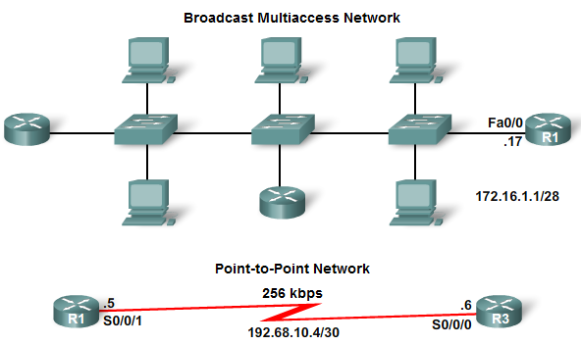
Challenges in Multiaccess Networks
Broadcast networks because a single device is capable of sending a single frame that has all devices on the network as its destination.
In contrast, on a point-to-point network, there are only two devices on the network, one at each end.
A multiaccess network is a network with more than two devices on the same shared media.
Examples of multiaccess networks include Ethernet, Token Ring, and Frame Relay.
Notes:
A multiaccess network is a network with more than two devices on the same shared media.
Examples of multiaccess networks include Ethernet, Token Ring, and Frame Relay.
Token Ring is LAN technology that is for the most part obsolete.
Frame Relay is a WAN technology that is discussed in a later CCNA course.

Slide 63
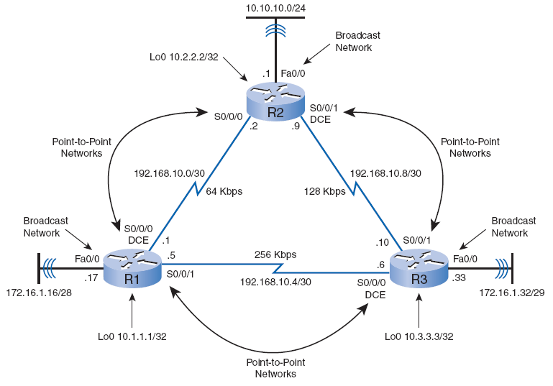
Challenges in Multiaccess Networks
OSPF defines five network types:
  Point to point
  Broadcast multiaccess
  Nonbroadcast multiaccess
  Point to multipoint
  Virtual links
Notes:
OSPF defines five network types:
Point to point
Broadcast multiaccess
Nonbroadcast multiaccess (CIS 83)
Point to multipoint (CIS 83)
Virtual links (CIS 185)

Slide 64
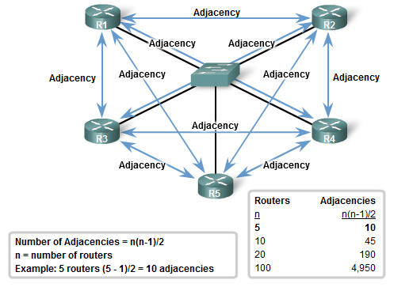
Challenges in Multiaccess Networks
Multiaccess networks can create two challenges for OSPF regarding the flooding of LSAs:
  Creation of multiple adjacencies, one adjacency for every pair of routers
  Extensive flooding of LSAs
Notes:
Multiaccess networks can create two challenges for OSPF regarding the flooding of LSAs:
Creation of multiple adjacencies, one adjacency for every pair of routers
Extensive flooding of LSAs
The creation of an adjacency between every pair of routers in a network would create an unnecessary number of adjacencies.
This would lead to an excessive number of LSAs passing between routers on the same network
For any number of routers (designated as n) on a multiaccess network, there will be n(n–1)/2 adjacencies.
Table shows how the number of adjacencies would grow exponentially.

Slide 65
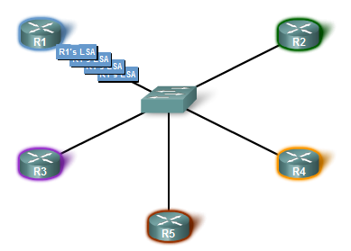
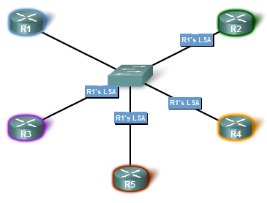
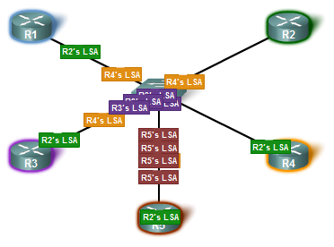
Flooding of LSAs
Link-state routers flood their link-state packets when OSPF is initialized or when there is a change in the topology.
In a multiaccess network, this flooding can become excessive.
Not shown in the figures are the required acknowledgments sent for every LSA received.
Notes:
Link-state routers flood their link-state packets when OSPF is initialized or when there is a change in the topology.
In a multiaccess network, this flooding can become excessive.
Not shown in the figures are the required acknowledgments sent for every LSA received.

Slide 66
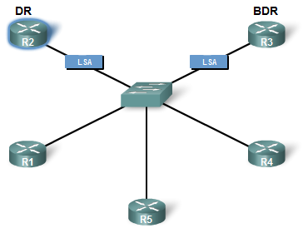
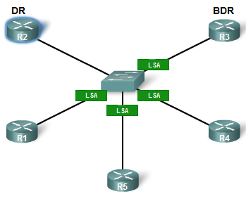
Solution: Designated Router
Here are LSAs from R1.
DROther
DROther
DROther
DROther
Here are my LSAs.
DROther
DROther
Designated Router (DR) is the collection and distribution point for LSAs sent and received.
A Backup Designated Router (BDR) is also elected in case the DR fails.
All other routers become DROthers.
Notes:
The solution to managing the number of adjacencies and the flooding of LSAs on a multiaccess network is the Designated Router (DR).
On multiaccess networks, OSPF elects a DR to be the collection and distribution point for LSAs sent and received.
A Backup Designated Router (BDR) is also elected in case the DR fails.
All other routers become DROthers.

Slide 67
Solution: Designated Router
Here are LSAs from R1.
To: 224.0.0.6
To: 224.0.0.5
DROther
DROther
DROther
DROther
Here are my LSAs.
DROther
DROther
DROthers only form full adjacencies with the DR and BDR.
  Send their LSAs to the DR and BDR
  Multicast address 224.0.0.6 (ALLDRouters, all DR routers).
R1 sends LSAs to the DR.
  BDR listens, too.
DR is responsible for forwarding the LSAs from R1 to all other routers.
DR uses the multicast address 224.0.0.5 (AllSPFRouters, all OSPF routers).
The result is that there is only one router doing all the flooding of all LSAs in the multiaccess network.
Notes:
DROthers only form full adjacencies with the DR and BDR in the network.
send their LSAs to the DR and BDR
using the multicast address 224.0.0.6 (ALLDRouters, all DR routers).
R1 sends LSAs to the DR.
The BDR listens, too.
The DR is responsible for forwarding the LSAs from R1 to all other routers.
The DR uses the multicast address 224.0.0.5 (AllSPFRouters, all OSPF routers).
The result is that there is only one router doing all the flooding of all LSAs in the multiaccess network.

Slide 68
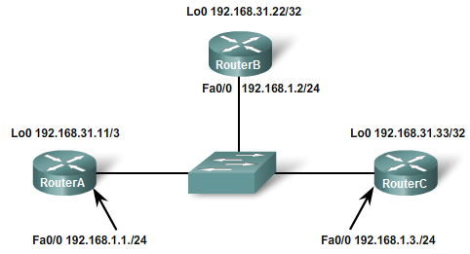
DR/BDR Election Process
DR/BDR elections do not occur in point-to-point networks.
In this new topology, we have three routers sharing a common Ethernet multiaccess network, 192.168.1.0/24.
Each router is configured with an IP address on the Fast Ethernet interface and a loopback address for the router ID.
Notes:
DR/BDR elections do not occur in point-to-point networks.
In this new topology, we have three routers sharing a common Ethernet multiaccess network, 192.168.1.0/24.
Each router is configured with an IP address on the Fast Ethernet interface and a loopback address for the router ID.

Slide 69
DR/BDR Election
Next Highest Router ID
BDR
Highest Router ID
DROther
DR
The following criteria are applied:
  1. DR: Router with the highest OSPF interface priority.
  2. BDR: Router with the second highest OSPF interface priority.
  3. If OSPF interface priorities are equal, the highest router ID is used to break the tie.
Default OSPF interface priority is 1.
Current configuration, the OSPF router ID is used to elect the DR and BDR.
Notes:
The following criteria are applied:
1. DR: Router with the highest OSPF interface priority.
2. BDR: Router with the second highest OSPF interface priority.
3. If OSPF interface priorities are equal, the highest router ID is used to break the tie.
Default OSPF interface priority is 1.
Current configuration, the OSPF router ID is used to elect the DR and BDR.

Slide 70
RouterA# show ip ospf neighbor (DROTHER) << Not part of the command
Neighbor ID Pri State Dead Time Address Interface
192.168.31.33 1 FULL/DR 00:00:39 192.168.1.3 FastEthernet0/0
192.168.31.22 1 FULL/BDR 00:00:36 192.168.1.2 FastEthernet0/0
RouterB# show ip ospf neighbor (BDR) << Not part of the command
Neighbor ID Pri State Dead Time Address Interface
192.168.31.33 1 FULL/DR 00:00:34 192.168.1.3 FastEthernet0/0
192.168.31.11 1 FULL/DROTHER 00:00:38 192.168.1.1 FastEthernet0/0
RouterC# show ip ospf neighbor (DR) << Not part of the command
Neighbor ID Pri State Dead Time Address Interface
192.168.31.22 1 FULL/BDR 00:00:35 192.168.1.2 FastEthernet0
192.168.31.11 1 FULL/DROTHER 00:00:32 192.168.1.1 FastEthernet0
DROthers
  Only form full adjacencies with the DR and BDR
  Still form a neighbor adjacency with any DROthers (receives Hello packets).
    Displayed as 2WAY.
Notes:
DROthers
Only form full adjacencies with the DR and BDR
Still form a neighbor adjacency with any DROthers (receives Hello packets).
Displayed as 2WAY.
The different neighbor states are discussed in CCNP.

Slide 71
RouterA# show ip ospf neighbor
Neighbor ID Pri State Dead Time Address Interface
192.168.31.33 1 FULL/DR 00:00:39 192.168.1.3 FastEthernet0/0
192.168.31.22 1 FULL/BDR 00:00:36 192.168.1.2 FastEthernet0/0
RouterB# show ip ospf neighbor
Neighbor ID Pri State Dead Time Address Interface
192.168.31.33 1 FULL/DR 00:00:34 192.168.1.3 FastEthernet0/0
192.168.31.11 1 FULL/DROTHER 00:00:38 192.168.1.1 FastEthernet0/0
RouterC# show ip ospf neighbor
Neighbor ID Pri State Dead Time Address Interface
192.168.31.22 1 FULL/BDR 00:00:35 192.168.1.2 FastEthernet0
192.168.31.11 1 FULL/DROTHER 00:00:32 192.168.1.1 FastEthernet0
The priority for all routers is the default 1.
Notes:
The priority for all routers is the default 1.

Slide 72
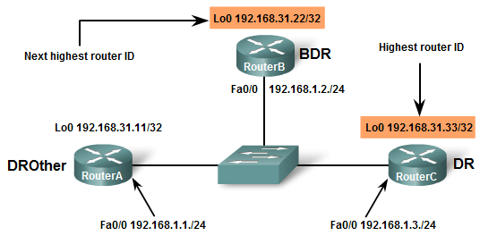
Verifying Router States
RouterA# show ip ospf interface fastethernet 0/0
FastEthernet0/0 is up, line protocol is up
Internet Address 192.168.1.1/24, Area 0
Process ID 1, Router ID 192.168.31.11, Network Type BROADCAST, Cost: 1
Transmit Delay is 1 sec, State DROTHER, Priority 1
Designated Router (ID) 192.168.31.33, Interface address 192.168.1.3
Backup Designated router (ID) 192.168.31.22, Interface address 192.168.1.2
Timer intervals configured, Hello 10, Dead 40, Wait 40, Retransmit 5
<output omitted>

Slide 73
Timing of DR/BDR Election
If I booted first and started the election before the others were ready, I would be the DR!
The DR and BDR election process takes place as soon as the first router with an OSPF enabled interface is active on the multiaccess network.
This could be a lower-end router that took less time to boot, which might not be the best router to handle the functions of the DR.
What would happen if the DR failed? Who would be the DR? Who would be the BDR?
Notes:
The DR and BDR election process takes place as soon as the first router with an OSPF enabled interface is active on the multiaccess network.
The election process only takes a few seconds.
If not all the routers on the multiaccess network have finished booting, it is possible that a router with a lower router ID will become the DR.
This could be a lower-end router that took less time to boot, which might not be the best router to handle the functions of the DR.
What would happen if the DR failed? Who would be the DR? Who would be the BDR?

Slide 74
Timing of DR/BDR Election
BDR
DR
BDR
X
DROther
DR
When the DR is elected, it remains the DR until one of the following conditions occurs:
  The DR fails.
  The OSPF process on the DR fails.
  The multiaccess interface on the DR fails.
If the DR fails, the BDR assumes the role of DR, and an election is held to choose a new BDR.
What if a new router joined the network with a higher Router ID? Would it be a DR, BDR or DROther?
Notes:
When the DR is elected, it remains the DR until one of the following conditions occurs:
The DR fails.
The OSPF process on the DR fails.
The multiaccess interface on the DR fails.
If the DR fails, the BDR assumes the role of DR, and an election is held to choose a new BDR.
What if a new router joined the network with a higher Router ID? Would it be a DR, BDR or DROther?

Slide 75
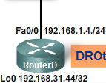
Timing of DR/BDR Election
I am a new router with the highest Router ID. I cannot force a new DR or BDR election, so I am a DROther.
DR
X
BDR
DROther
What if a new router with a higher Router ID enters the network?
What if RouterC (previous DR) came back? With its higher Router ID than RouterB (DR) and RouterA (BDR) would it be a DR, BDR or DROther?
Notes:
If a new router enters the network after the DR and BDR have been elected, it will not become the DR or the BDR even if it has a higher OSPF interface priority or router ID than the current DR or BDR.
The new router can be elected the BDR if the current DR or BDR fails.
If the current DR fails, the BDR will become the DR, and the new router can be elected the new BDR.
What if RouterC (previous DR) came back? With its higher Router ID than RouterB (DR) and RouterA (BDR) would it be a DR, BDR or DROther?

Slide 76
Timing of DR/BDR Election
I’m back but I don’t get to become DR again. I am now just a DROther.
DR
X
BDR
DROther
DROther
A previous DR does not regain DR status if it returns to the network.
What would happen if the RouterA (BDR) failed? Who would be the new BDR? Would the DR change?
Notes:
A previous DR does not regain DR status if it returns to the network.
RouterC has finished a reboot and becomes a DROther even though its router ID, 192.168.31.33, is higher than the current DR and BDR.
What would happen if the RouterA (BDR) failed? Who would be the new BDR? Would the DR change?

Slide 77
Timing of DR/BDR Election
Amongst the DROthers I have the highest Router ID, so I am the new BDR!
DR
X
BDR
DROther
DROther
BDR
What if RouterB also fails? Who would be the new DR? Who would be the BDR?
Notes:
If the BDR fails, an election is held among the DROthers to see which router will be the new BDR.
RouterD wins the election with the higher Router ID.
Although RouterD has a higher Router ID than RouterB (DR), it will not become the DR.
What if RouterB also fails? Who would be the new DR? Who would be the BDR?

Slide 78
Timing of DR/BDR Election
X
DR
I am now the new BDR!
I am now the new DR!
DROther
X
BDR
DR
Notes:
RouterB fails.
Because RouterD is the current BDR, it is promoted to DR.
RouterC becomes the BDR.

Slide 79
Timing of DR/BDR Election
To simplify our discussion, we removed RouterD from the topology.
How can we make sure RouterB is the DR and RouterA is the BDR, regarless of RouterID values?
I want to be the DR
I have the highest Router ID
I want to be the BDR
Choosing a DR and BDR
We can change the OSPF interface priority to better control our DR/BDR elections.
Notes:
Choosing a DR and BDR
Without further configurations, the solution is to do either of the following:
Boot up the DR first, followed by the BDR, and then boot all other routers.
Shut down the interface on all routers, followed by a no shutdown on the DR, then the BDR, and then all other routers.
However, as you might have already guessed, we can change the OSPF interface priority to better control our DR/BDR elections.

Slide 80
OSPF Interface Priority
Router(config-if)# ip ospf priority {0 - 255}
Important for this router to have sufficient CPU and memory capacity to handle the responsibility.
Control the election of these routers with the ip ospf priority interface command.
Priority (Highest priority wins):
  0 = Cannot become DR or BDR
  1 = Default
    Therefore, the router ID determines the DR and BDR.
Notes:
Important for this router to have sufficient CPU and memory capacity to handle the responsibility.
Control the election of these routers with the ip ospf priority interface command.
Priority (Highest priority wins):
0 = Cannot become DR or BDR
1 = Default
Therefore, the router ID determines the DR and BDR.
Priorities are an interface-specific value, they provide better control of the OSPF multiaccess networks.
They also allow a router to be the DR in one network and a DROther in another.

Slide 81
OSPF Interface Priority
RouterA# show ip ospf interface fastethernet 0/0
FastEthernet0/0 is up, line protocol is up
Internet Address 192.168.1.1/24, Area 0
Process ID 1, Router ID 192.168.31.11, Network Type BROADCAST, Cost: 1
Transmit Delay is 1 sec, State DROTHER, Priority 1
Designated Router (ID) 192.168.31.33, Interface address 192.168.1.3
Backup Designated router (ID) 192.168.31.22, Interface address 192.168.1.2
Timer intervals configured, Hello 10, Dead 40, Wait 40, Retransmit 5
<output omitted>
The OSPF interface priority can be viewed using the show ip ospf interface command.
Notes:
The OSPF interface priority can be viewed using the show ip ospf interface command.

Slide 82
Highest priority wins
Pri = 100
Pri = 200
RouterA(config)# interface fastethernet 0/0
RouterA(config-if)# ip ospf priority 200
RouterB(config)# interface fastethernet 0/0
RouterB(config-if)# ip ospf priority 100
After doing a shutdown and a no shutdown on the Fast Ethernet 0/0 interfaces of all three routers, we see the result of the change of OSPF interface priorities.
Notes:
After doing a shutdown and a no shutdown on the Fast Ethernet 0/0 interfaces of all three routers, we see the result of the change of OSPF interface priorities.

Slide 83
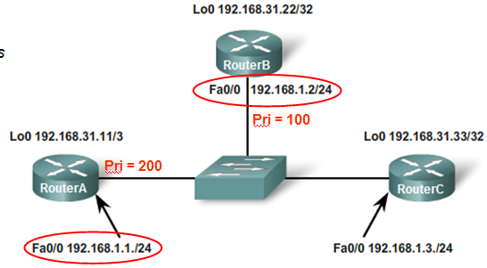
BDR
Highest priority wins
DR
DROther
RouterA# show ip ospf neighbor (DR)
Neighbor ID Pri State Dead Time Address Interface
192.168.31.22 100 FULL/BDR 00:00:30 192.168.1.2 FastEthernet0/0
192.168.31.33 1 FULL/DROTHER 00:00:30 192.168.1.3 FastEthernet0/0
RouterB# show ip ospf neighbor (BDR)
Neighbor ID Pri State Dead Time Address Interface
192.168.31.11 200 FULL/DR 00:00:37 192.168.1.1 FastEthernet0/0
192.168.31.33 1 FULL/DROTHER 00:00:38 192.168.1.3 FastEthernet0/0
RouterC# show ip ospf neighbor (DROTHER)
Neighbor ID Pri State Dead Time Address Interface
192.168.31.22 100 FULL/BDR 00:00:32 192.168.1.2 FastEthernet0/0
192.168.31.11 200 FULL/DR 00:00:31 192.168.1.1 FastEthernet0/0

Slide 84
Questions
Does OSPF support load balance? Does it support equal load balance?
How is OSPF Metric calculated?
What is the command to see neighbor table?
Should there be DR and BDR in any network?
What is the function of Virtual link?
How to determine router-ID?
What features of hello message must be the same to its neighbor router to enable communication?
What is the importance of DR and BDR in your network?
OSPF requires hierarchical design in its configuration. What does it mean?
What is the default time for hello, dead, retransmit?

